Slide 1
Welcome
Damian Lee
Headteacher

Slide 2
Introduction
About me - who am I?
My vision
Why did I choose Mayflower?
What are my initial thoughts?
What can you expect from me as Headteacher of Mayflower?
What do I expect of students and staff at Mayflower?
What do I expect from you as a parent?
How are we going to achieve our goals?

Slide 3
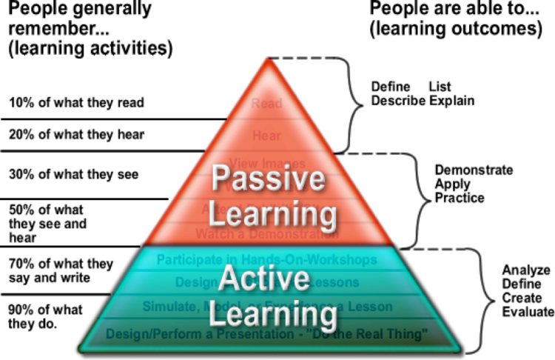

Slide 4
Damian Lee - the professional
Worked in education for 22 years (PE, maths & Science)
15 years as a Senior Leader
7 years as a Headteacher
2 years as an Executive Principal
1 year as a Regional Executive Principal
Experience of working within an LA school and a large national MAT

Slide 5
Damian Lee - the person
Born and raised in Croydon - South London
Irish mother (teacher), English dad - family of 7
First generation to go to
university
My own educational
experience
Moved to Essex 22 years ago
Married to Hayley - 12 years
Two beautiful daughters
Freya (8) and Elsie (5)
Love sport - playing and watching
and travelling

Slide 6
My vision for Mayflower
Success, happiness and opportunity for all
Key drivers that underpin our vision
Excellent teaching in every classroom, for every child, every day
Ambitious outcomes for all students
Strong sense of identity and ability to thrive
A beacon within our local community

Slide 7
Why did I choose Mayflower High School?
Wanted to lead one school again
Students on my tour
Mayflower always been a school to admire
Reputation and previous visits
Interview - confirmed it was a place I could see myself for at least the next 5-10 years

Slide 8
What are my initial thoughts?
Uniform
Little (if any) resistance to change
Amazing young people
Experienced staff
Relationships
Inward facing

Slide 9
What can you expect from me as Headteacher of Mayflower?
Presence
Honesty
Ambition and dedication to be the very best - development of others
Consistency and fairness
Recruitment and retention of the very best teachers

Slide 10
What do I expect of students and staff at Mayflower?
Be the very best version of themselves they can
Doing the right thing - even when no one is looking
Challenge what is wrong and promote what is right
Politeness
Pride

Slide 11
What do I expect from you as a parent?
Hold me to account
Help and support - understand the journey
Use the correct lines of communication
Market Mayflower
PTA

Slide 12
How are we going to achieve our goals?
Recruitment and retention
Short, medium & long term goals
Collective efficacy
Creating the right culture and ethos

Slide 14
Culture & Ethos
Process of improving a school
Culture, ethos, behaviour and pride
T&L teacher development and quality of education
Outcomes
Inspiring teaching alongside a rich cultural capital
Relationships and high expectations

Slide 15
Short, medium and long term goals
Short term
Medium term
Long term
Urgent priorities | Building blocks | Sustainability
Define and develop a culture and ethos of excellence Improve community links and parent voice Implementing a robust behaviour system | Refine curriculum intent and implementation (whole school and departmental) Develop staff using an instructional coaching model Develop curiosity and passion for lifelong learning | Further improved outcomes and progress scores for all, including disadvantaged students Excellence in all areas of school life Maintenance of reputation improved OFSTED rating
Notes:
Short term - urgent priorities that need to be addressed,
Mid term - is building the core foundation of the school,
Long term - is sustainability and keeping the school operating at …

Slide 16
Schools are either improving or declining
Being part of the journey - change management
Collective efficacy
Ofsted

Slide 17
Thank you for your time this evening

