Slide 1

SEND
Mayflower High School

Slide 2
The Progress Centre
At Mayflower in the Progress Centre we value the importance of teamwork with parents/carers, students and staff in order to ensure a positive learning experience for every student. Throughout your child’s time at Mayflower High School, parents are given regular opportunities to meet and discuss your child’s needs, progress and concerns.

Slide 3
The Department
Richard Griffiths– SENCO
Sally Nichols– Assistant SENCO
Kate Bunyan – Assistant SENCO
All teachers hold the SENCO Award Qualification.
In addition, there are 14 Teaching Assistants (TAs) who provide both in-class support and work 1:1 or in small groups with students.

Slide 4
Key Stage 3
Students follow the normal school timetable with in class support.
In Year 8 & 9 targeted students are withdrawn from MFL. They receive additional Maths & English support lessons.

Slide 5
Key Stage 4
Students follow the normal school timetable with in class support.
Targeted students study BTEC Workskills in place of a GCSE option subject.
Targeted students can select Study Skills in place of a GCSE option subject.

Slide 6
Student Passports
A Student Passport, is a document which lists strategies and support methods specific to each student with SEND.

Slide 7
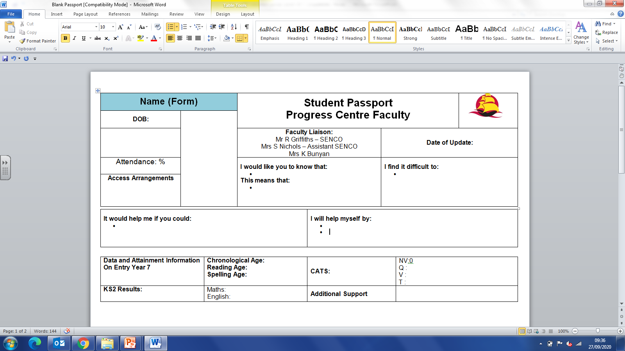
Student Passport

